Slide 1
And Criticism
Notes:
Instructor's Guidance:
Organizations and the job environment are main sources of cynicism development. It is not the intent of this presentation to address or attempt to make organizational changes to lower cynicism. The focus of this topical presentation is on the individual's attitude, perceptions and reactions. Cynicism is the ultimate accumulation of all the Risk Factors identified in the LEO Suicide Profile. So it will be covered as a potential treatment and used as prevention plan.
Instructor's Notes:
The word cynicism is a Greek word and it means that it is not possible to find really honest people in the world. In almost all organizations there are at least a few people who are cynical. The words cynicism and skepticism are used but always confused researchers. There are a few individuals who face this attitude i.e. cynicism.
Rude behavior, ignorance, are some of the sources and reasons for cynicism.
Lack of commitment, lack of resources, increased job demands are sources of cynical behavior and ‘bad’ attitudes.
Cynicism gave rise to these negative behaviors. Unethical behavior, unethical climate, injustice also make the employees cynical.
This attitude is harmful for employee as well as organizations.
A cynical attitude brings depression, burnout and emotional exhaustion among individuals. Those people who have cynical attitudes tends to have more inclination towards participating in unethical and disloyal behaviors.
This is a negative attitude of employees to their organization that usually lacks integrity and leads to negative effect towards the workplace. This attitude results in frustration, distrust of group, individual or persons. Cynical persons think that there is no justice, no ethics and no equality in organization.
Bottom line this is an individual attitude that needs to change.

Slide 2
Notes:
Instructor's Notes:
Lead a facilitative discussion on the results of the survey and then move into the cynicism presentation
Poll Title: Since becoming a First Responder/LEO I have noticed and observed that I https://www.polleverywhere.com/multiple_choice_polls/UdZnaVM3bmvegzWLPMfhp

Slide 3
A cynic is a man who knows the price of everything, and the value of nothing - Oscar Wilde
Notes:
Instructor's Notes:
LEOs and first responders typically encounter people at their worse and under negative circumstances and these perceptions can produce similar reactions can produce corresponding behaviors to
See the world differently
Look at people differently
React to situations differently
Cynicism – a distrust of other’s motive and human nature and can create a "Fishbowl" mentality
“This is all just more BS.”
“This job be great if it weren’t for the BS.”
And home life:
Social alienation (“it’s all BS) and cynicism can isolate a First Responder from the stress of the job but can also lead to isolation at home.
This includes lose of earlier friendships.
The “I usta” syndrome
But this does not have to happen and it is avoidable

Slide 4
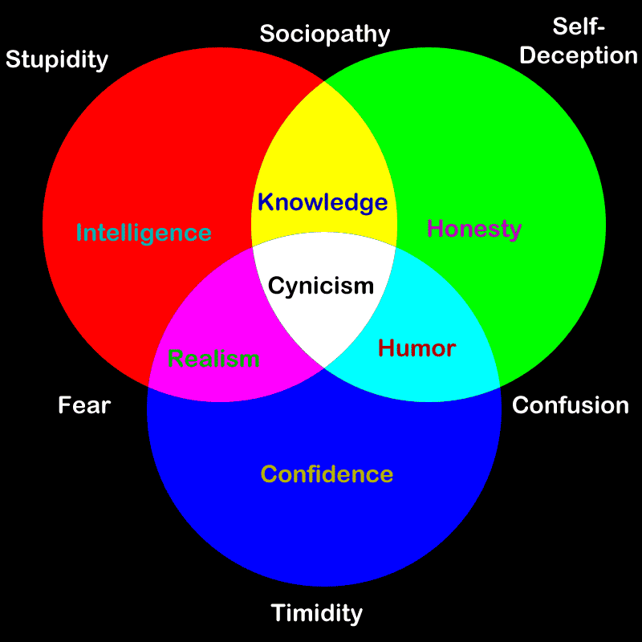
Notes:
Instructor's Notes:
There are many dynamics that going into the construction of cynicism. These are all attitudes, miss-perceptions and over-reactions. These can be employed to change and grow new healthy perceptions and reactions. For example:
Humor, develop a sense of humor, laugh and perceive the hilarity of the situation/organization.
Realism, the acceptance of reality, such as the situation/organization isn't going to change and its not my position to make the changes. Now make a decision as to how you perceive and reaction to this realty.
Knowledge is power, locate your power and use what you have to move away from the inner circle of cynicism.
Confidence, Honesty and Intelligence can all be used to bring about correct perceptions and reactions to the situation/organization.

Slide 5
Notes:
Talking Points for Instructors:
All LEO's encounter and deal with criticism, personally and professionally.
And we get about the same results all over the country
Additional Instructor Notes and Guidance:
Allow the class time to put in their responses and see the polling work
Once the changes slow down, that’s a good indication to proceed
After the results are in, it’s likely going to show that many (most?) have some concepts and perspectives on criticism.
Poll Title: On a daily bases the majority of criticism in my life comes from https://www.polleverywhere.com/multiple_choice_polls/b5OPBThjrQMyPrlHndFoM

Slide 6
Criticism
Notes:
Instructor's Guidance:
This topical portion follows the curriculum design on Mindful Coaching and the practices of Mindfulness training
Instructor's Talking Points:
All LEOs receive criticism. From supervisors, administrators, citizens, political figures, co-workers and even loved ones.
How criticism is processed within the individual is the key to wellness and health.
Criticism can sting in any situation, whether or not the criticism has merit. While some people are able to consider and integrate helpful criticism and experience no lasting effect from it, others find it more difficult to accept and digest and experience extreme defensiveness and/or negative affect (typically, anxiety, depression, anger, and shame).
High sensitivity to criticism has been found to be related to high levels of neuroticism, depression, fear of negative evaluation, pessimistic explanatory style, and low scores on self-esteem (Atlas, 1994). Oversensitivity to criticism can hinder an adaptive response to said criticism, even when that criticism is constructive and intended to be helpful. Further to this, oversensitivity to criticism can develop into a fear of criticism, and this fear can result in avoidance of opportunities to receive critical feedback (Atlas, 1994).
While it may not be possible to avoid being criticized by people in life, one can learn to react and respond in more helpful and less damaging ways. One such way is to adopt a growth mindset, which means approaching the criticism as an opportunity for personal growth and learning (Dweck, 2008). Approaching criticism with a fixed mindset, by comparison, would be to interpret this feedback as challenging and threatening to one’s personal capabilities. In this exercise, clients will examine their tendency to be oversensitive to criticism and explore how to reframe the experience of criticism as an opportunity for growth and learning.

Slide 7
Always remember, you’re braver than you believe, stronger than you seem, and smarter than you think.” – A.A. Milne
Notes:
Instructor's Notes:
Having a growth mindset is not the full story; a growth mindset must be translated into action.
A growth mindset in action means that we allow ourselves to fail, to make mistakes, and persist in those areas that we have not yet mastered, despite our fears and discomfort.
The growth that is experienced by people with a growth mindset does not happen within the comfort zone; the space in which we explore only the things we know; the things that we feel we know and can control. In order to learn and grow from a situation, one must venture beyond the comfort zone into what can be called the fear zone.

Slide 8
Leave your comfort zone….fear…learn…..grow
Notes:
Instructor's Notes:
The fear zone is, by definition, scary and uncomfortable; it is the zone that prevents most people from ever leaving the comfort zone. However, those with a growth mindset are more able to endure the fear zone in the service of growth and learning. These people are able to experience the benefits of venturing beyond their comfort zone, which makes it easier and more attractive to do it again.
Growth and fear go hand in hand. One cannot grow without experiencing fear. Highlighting the notion that fear is virtually a prerequisite for growth and learning may increasing willingness and acceptance of fear. learning involves getting things wrong and can often require struggle and discomfort (the fear zone). Emphasize that the experience of failing or finding something difficulty actually allows clients to progress with learning.
Learning and growth is not a linear process, where people move through the different zones and “reach” the growth zone. In reality, however, this process is highly dynamic and continuous. People may enter the learning zone and fall back to the fear zone when new, unforeseen challenges are presented. The process of growth is a process of falling and getting up, where it is per definition impossible to reach the growth zone and stay there. As soon as the growth zone is accomplished, the client has created a new “comfort zone”, and the process outlined in this tool repeats itself.

Slide 9
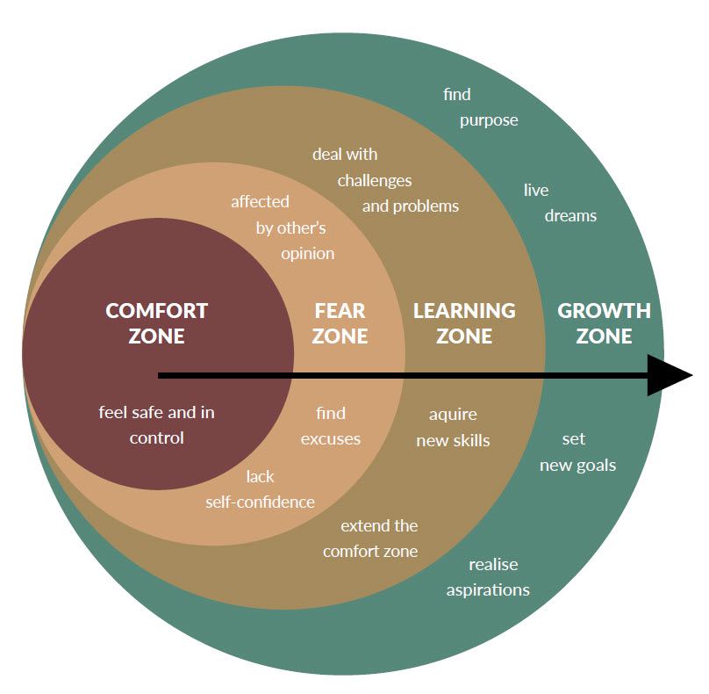
Notes:
Instructor's Notes:
Comfort Zone: The red circle represents our comfort zone. It is the space in which we feel safe and in control. Here, things come easy for us. We know what to do and what to expect. However, no learning or growth takes place here, because we rely on the things we already know and have been doing over and over again.
Fear Zone: For us to learn and grow, we must leave the comfort zone and step into the fear zone (orange circle), which is far less comfortable. In fact, the fear zone is very uncomfortable. We do not know what to expect and cannot build on our previous experiences. This new way is paved with uncertainty. Consequently, we often tend to try to avoid this space and make excuses as to why we cannot go there. And even if we find the courage to leave the comfort zone, the fear of the unknown can cause us to move back quickly to our comfort zone. The fear zone is often the most challenging part of learning and growth journey.
Learning Zone: If we can muster up the courage to endure the fear zone, we come out the other side, into the learning zone. The learning zone (yellow circle) is where we can begin to acquire new skills and learn to deal with challenges and problems. When we make it to the learning zone, we actually extend our comfort zone, meaning that we begin to feel comfortable in this previously uncomfortable experience.
Growth Zone: When we stay long enough in the learning zone, we begin to experience that we are able to change and start to redefine ourselves in terms of what can we can do, achieve and feel comfortable with. Over time, we enter the growth zone (green circle). Staying long enough in the learning zone has helped us to grow as a person, at multiple levels. We may have increased our resilience by conquering obstacles, we have created a pathway that makes it easier for us to follow our dreams, we may have experienced a sense of meaning by investing time in something that really matters to us. The growth zone is the bigger picture; that which we have gained at a more fundamental, personal level. Entering the growth zone is the ultimate reward for enduring the fear zone.

Slide 10
Practice self-compassion
Don't take it personally
Notice your inner negative self-critical voices
Re-affirm yourself
Reflect on the criticism
Do not become defensive in the moment
Forgive yourself
Manage your emotions
Resist the urge to "counter-critique."
Thank the person offering you feedback
Notes:
Instructor's Notes:
1. Practice self-compassion. Offer yourself compassion during moments of criticism. Acknowledge to yourself that being criticized can hurt and change your inner talk to match what you would say to a friend or loved one whom you care about.
2. Don’t take it personally. Notice what someone is saying objectively, without taking it on board as a personal attack. Listen to feedback with an open mind.
3. Notice the automatic negative, self-critical voice that pipes up when someone criticizes you, and mentally dial down the volume.
4. Repeat to yourself affirming statements such as: “I am seeking improvement not approval” and “This is an opportunity for growth and learning.”
5. Reflect on the criticism you have received, and in instances where you have been wrongly criticized, assert yourself and speak up about it.
6. Try not to become defensive in the moment. If you feel the urge to snap back, step away and rethink your response.
7. Forgive yourself. Repeat phrases such as “I did the best I could,” “My intentions are positive,” “I can’t always be perfect,” “I let that person down, but I forgive myself,” “I’m going to make mistakes sometimes; everyone does,” “I’m not a bad person just because I made a mistake,” and so on.
8. Manage your emotions. If you feel yourself becoming emotional and/or overly defensive upon being criticized, step away and take some mindful breaths to calm down, and postpone the conversation if need be.
9. Resist the urge to offer a ‘counter critique’ in response if you are upset or angry.
10. Thank the person offering you feedback, even if it was not constructive or helpful.

